Slide 1
Pixel snake _ game
COMPUTER GRAPHICS
MINI PROJECT
SECTION : 3CSD3
Ananya P S - 20221CSD0106

Slide 2
GAME WORKING
In a pixel snake game, you control a snake on a grid, eat pixels to grow, and score points. Avoid colliding with the snake's body or boundaries. Use arrow keys to navigate. The game ends if you collide. The goal is to maximize your score by eating pixels and surviving.

Slide 3
2. Grid Layout: The game's graphics are organized in a grid-based layout, with each grid cell corresponding to a pixel.
3. Color Palette: A limited color palette, often defined by RGB values, contributes to the retro aesthetics of pixel art.
4. Dynamic Rendering: Pixels representing the snake and objects dynamically change as the game progresses, updating positions and lengths.
5. Collision Detection: Computer graphics handle collision detection by checking pixel intersections, crucial for gameplay mechanics.
6. User Input Handling: The graphics engine responds to user input, translating arrow key presses into changes in the snake's direction.
7. Rendering Text and UI: Computer graphics render text and user interface elements, providing feedback and displaying information like the player's score.
8. Frame Rendering: Continuous frame rendering ensures smooth animations, such as the snake's movement and growth.
9. Game Over Animation: When the game concludes, computer graphics display a game over message or animation, concluding the player's experience.

Slide 4
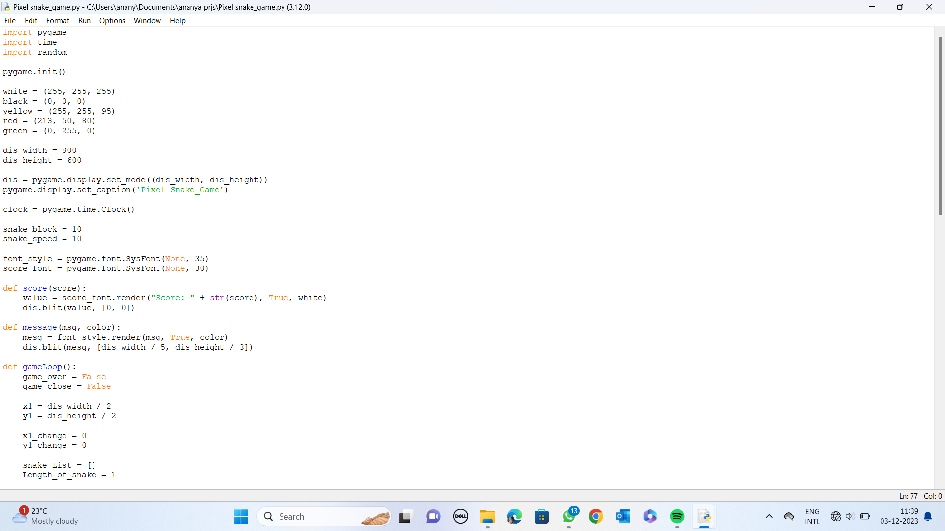

CODing
PYTHON LIBRARIES
This Photo by Unknown Author is licensed under CC BY-NC

Slide 5
Part 1: Initialization and Setup
This part initializes the Pygame library, sets up color variables, defines display dimensions, creates a Pygame window, and sets the window caption.
It includes :
pygame.init(): Initializes the Pygame library.
Color Definitions: RGB values are used to define colors (white, black, yellow, red, green).
dis_width and dis_height: Define the dimensions of the game window.
dis: Creates the game window using Pygame.
clock: Used to control the frame rate.

Slide 6
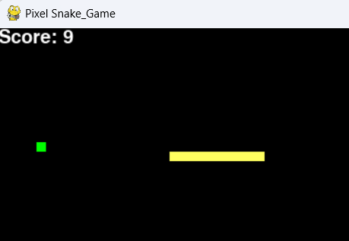
Part 2: Game Configuration
Here, you define the size of the snake block, its speed, and set up fonts for displaying the score and game messages.
It includes
snake_block: Size of each block in the snake.
snake_speed: Speed of the snake's movement.
font_style and score_font: Pygame fonts used for displaying text.

Slide 7
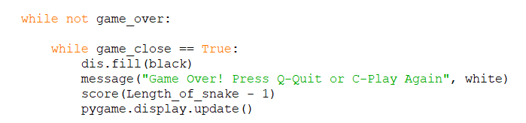
Part 3: Score and Message Functions
These functions handle rendering the player's score and displaying messages on the screen.
score(): Renders and displays the player's score on the game window.
message(): Renders and displays messages on the game window.
The game also includes a feature where, it displays a message “Game over! Press q to quit, press c to play again”.

Slide 8
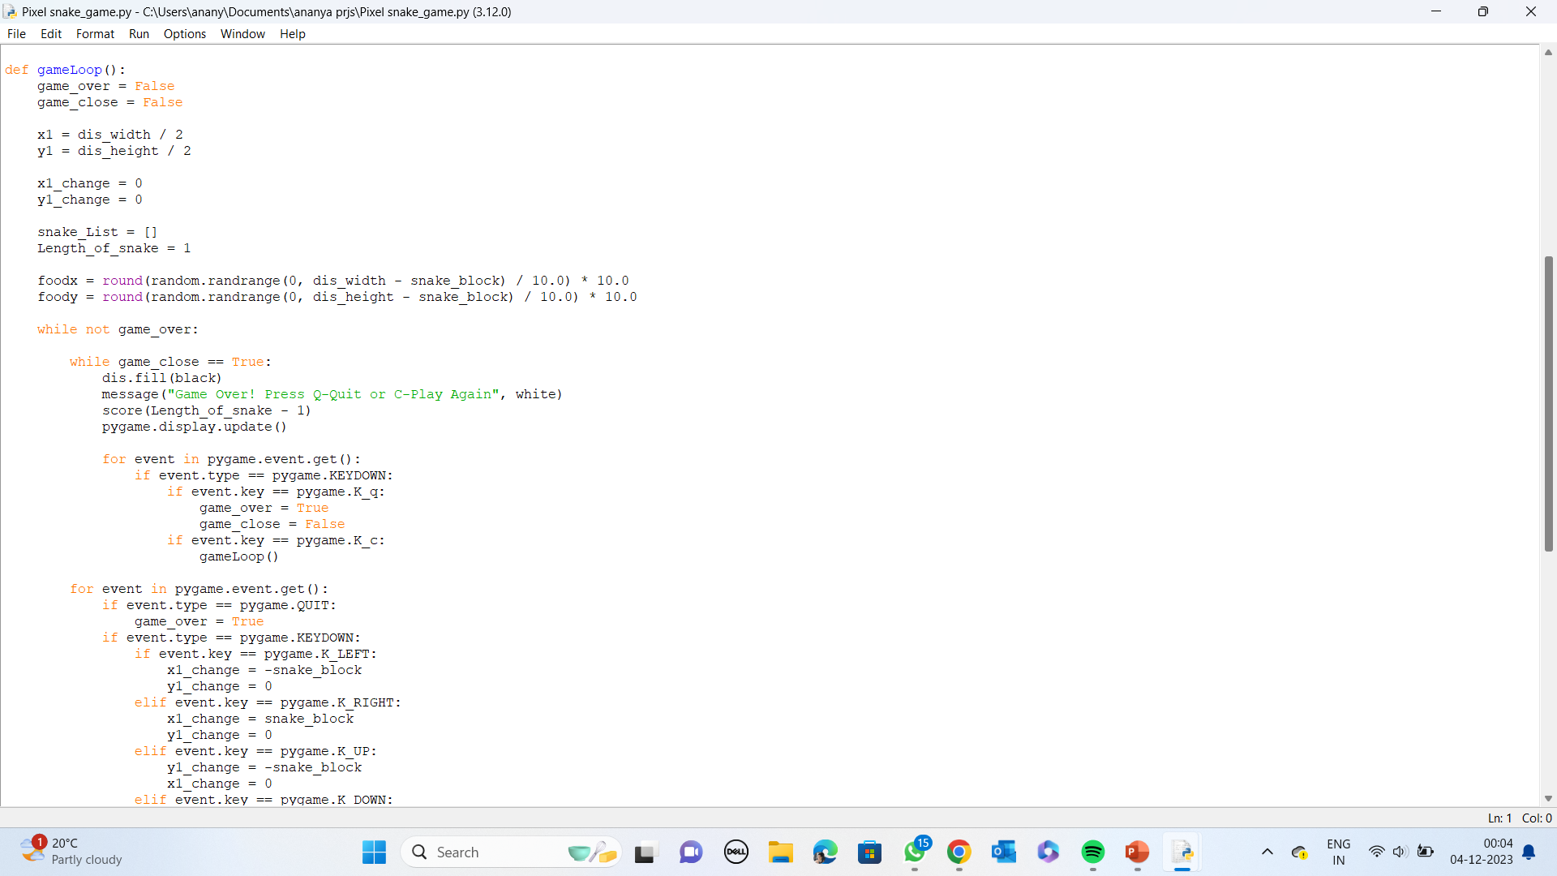
PART 4: GAME LOOP
The gameLoop() function initializes variables for the game state, snake position, length, and the initial food position.
The game starts with a while loop (while not game_over) that continues until the game is over.
Inside the game loop, when game_close is True, it displays a game over message, the player's score, and instructions to play again or quit.
It waits for the player's input and reacts accordingly (quitting or restarting the game).

Slide 9
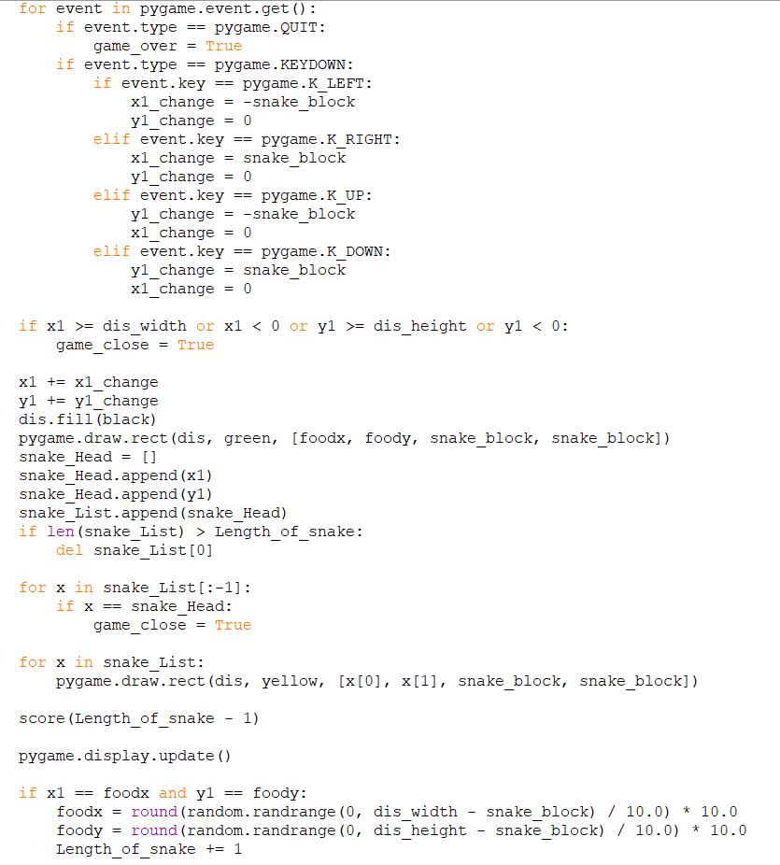
PART 5: THE GAME ALGORITHM
The main part of the game loop handles user input, updates the snake's position, checks for collisions with walls or itself, and updates the display.
If the snake eats the food, it increases in length, and a new food position is generated.
It consists of the game algorithm that includes scaling(increase in length of the snake),translation(movement of the snake) and rotation (changing the direction).
The code contains functions such as append, change, update etc to perform these operations.
It also includes a quit option to exit the screen.

Slide 10
THANK YOU

